Slide 1
Data distribution (before pre-filtering)
60,483 genes and 88 samples

Slide 2
Data distribution (after pre-filtering)
4337 genes and 88 samples
(filter criteria: genes that has values greater than 2 in at least 10 samples out of 88 samples)

Slide 3
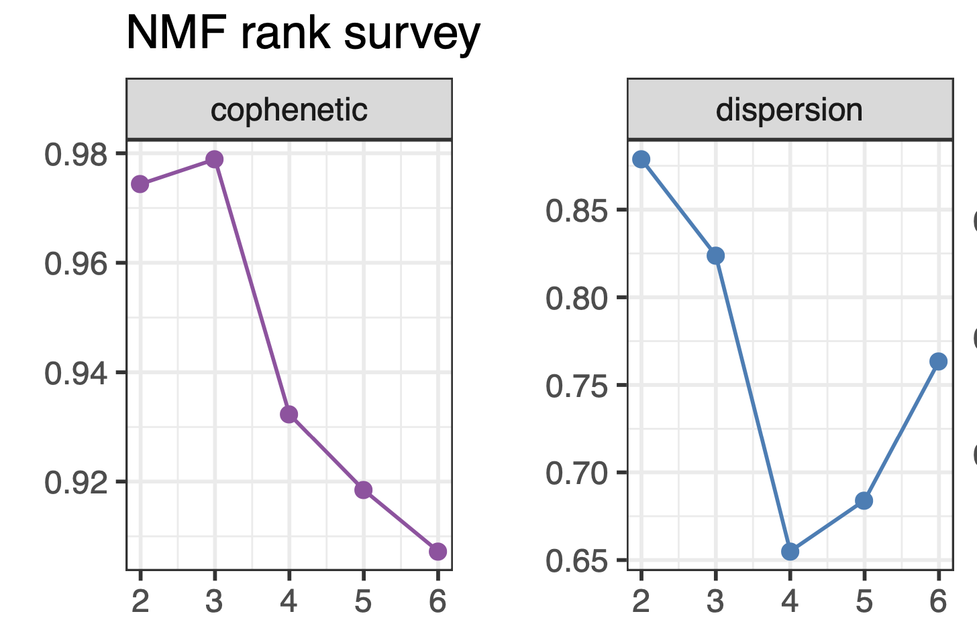
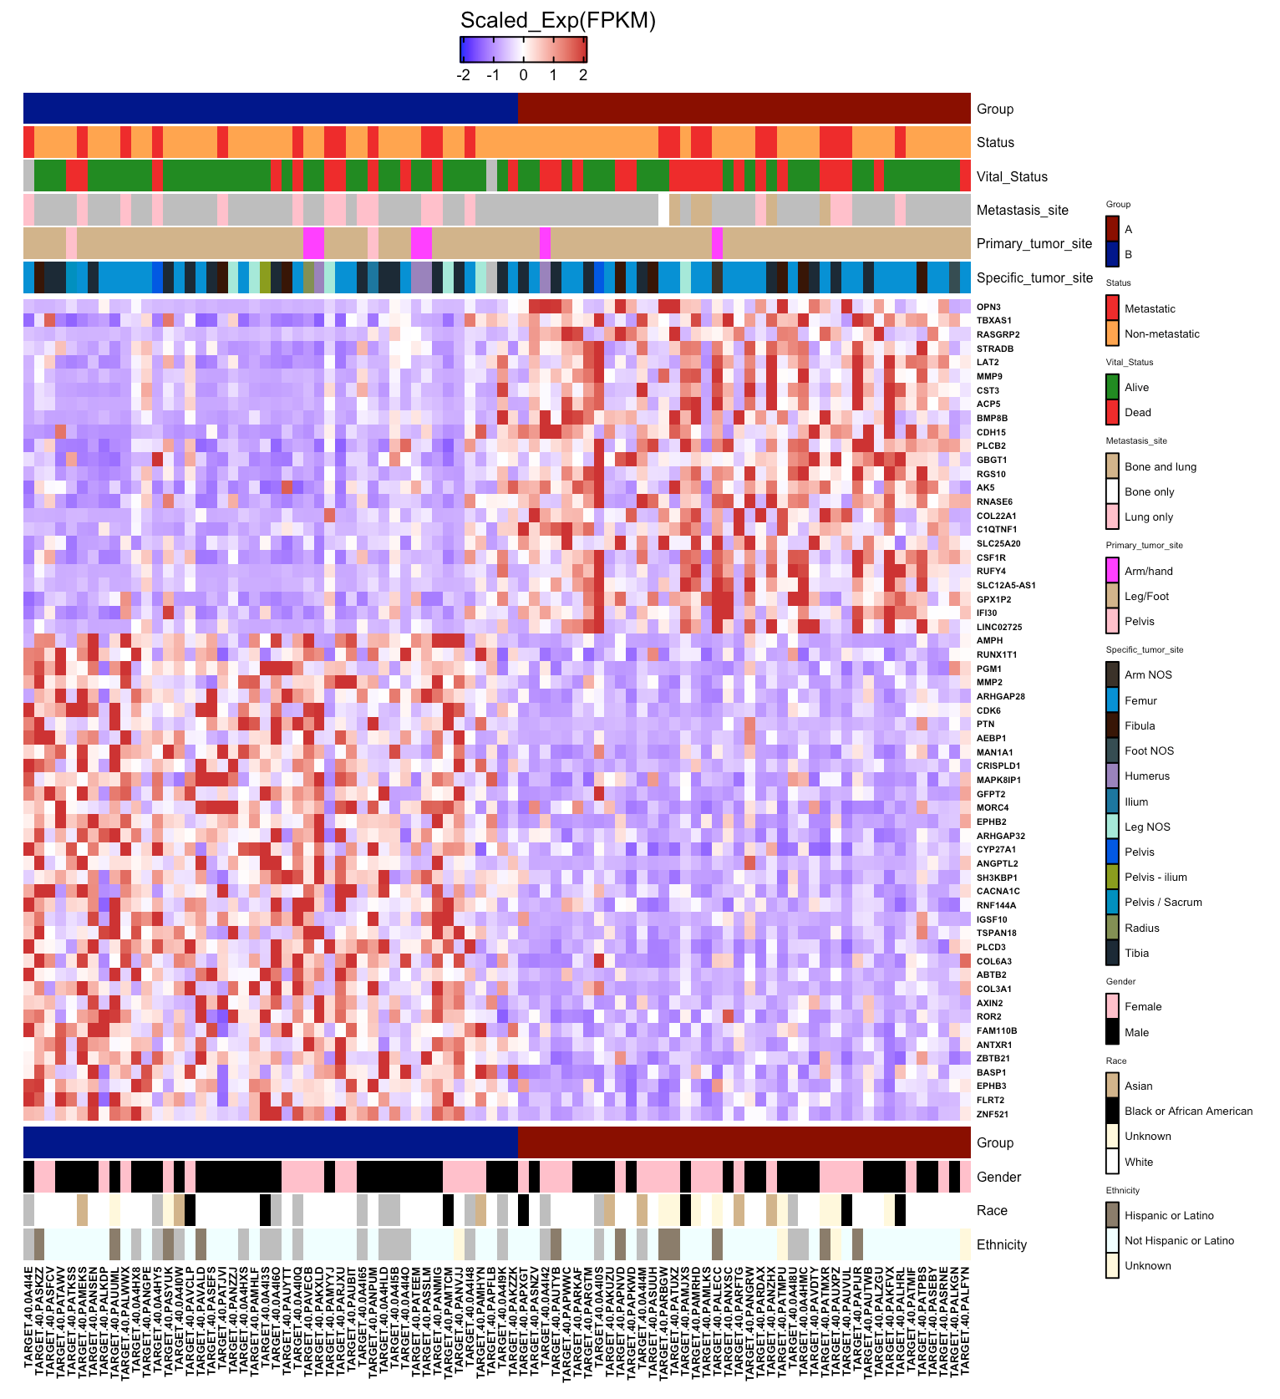
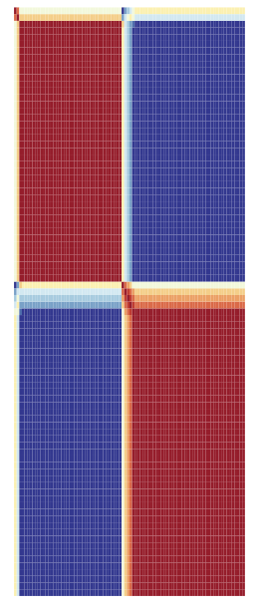
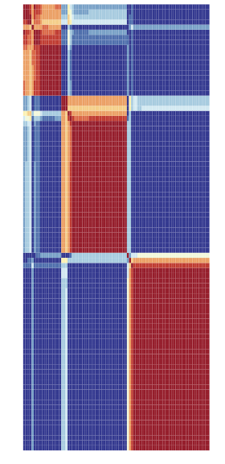
OS_TARGET_data
NMF using 15k genes, 3 groups
Pre-filtering : 60K genes to 15K genes
Criteria: expressed in at-least in 25% of sample
(value of greater than 1fpkm in at least 22 samples)

Slide 4
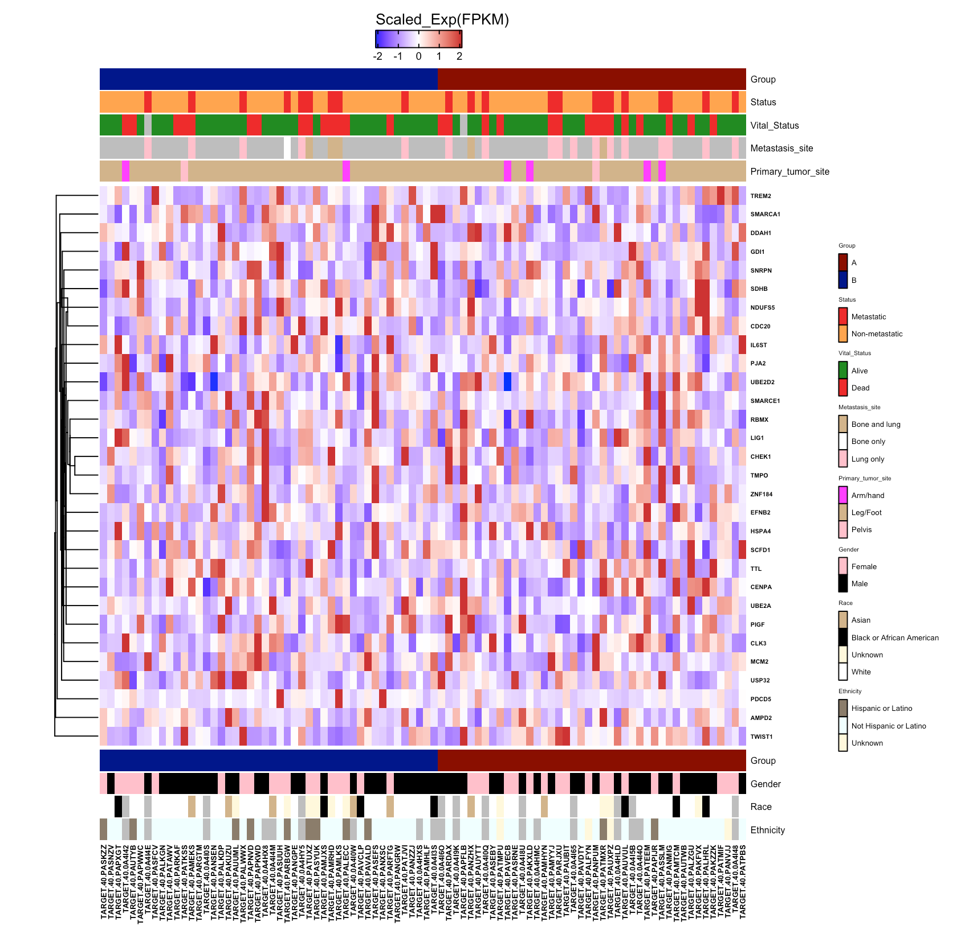
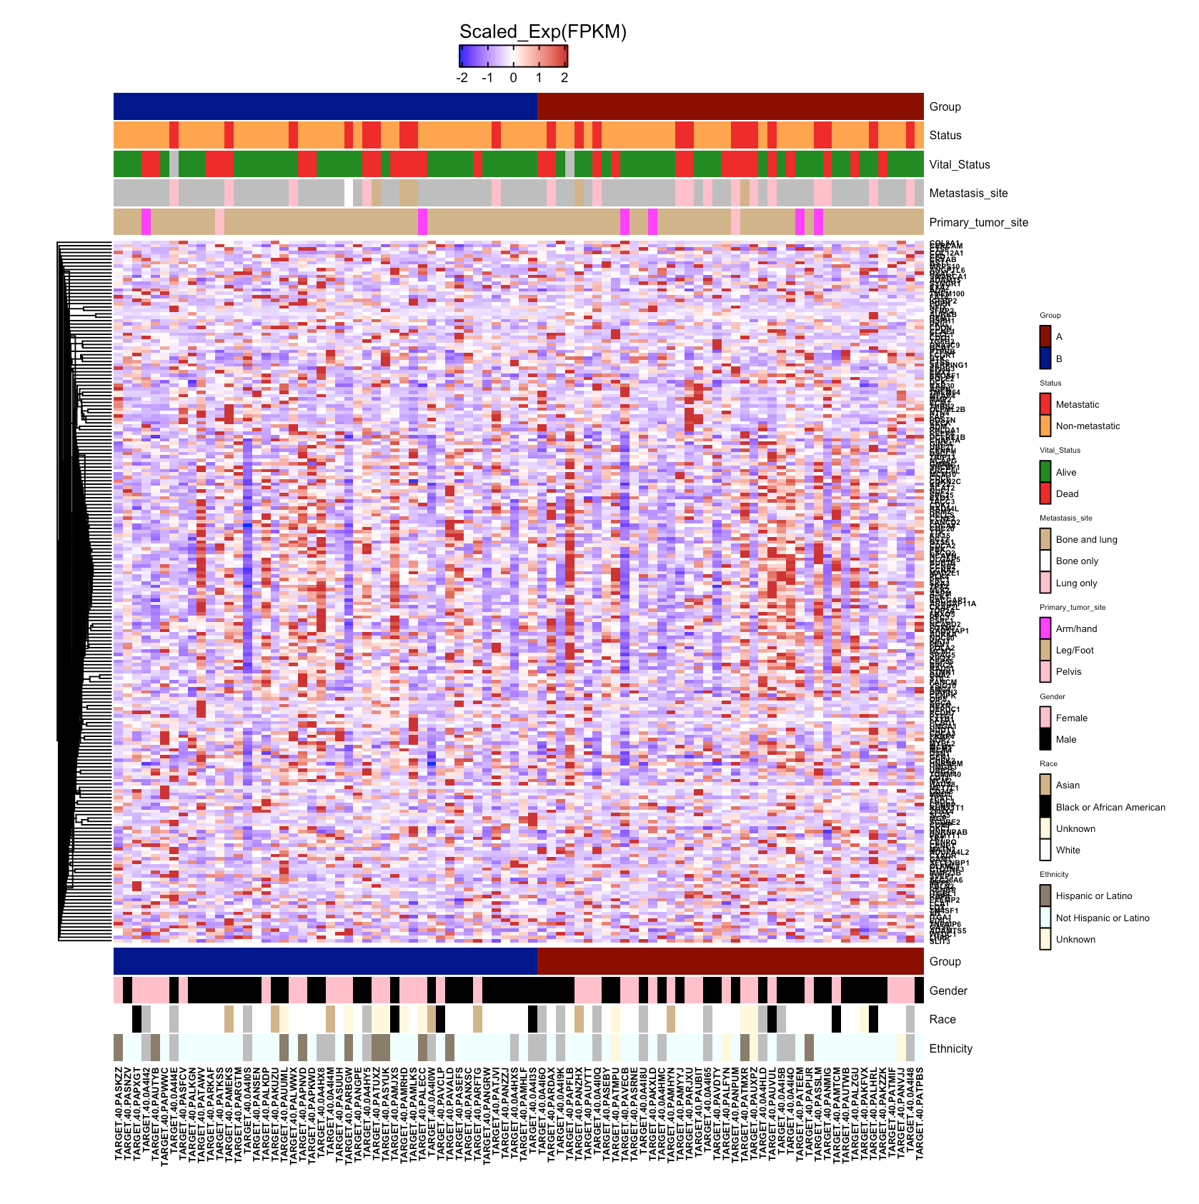
Using published OS gene sets to plot 2 subtypes
OS genes from Man et. al, 2005
OS-Canine genes from Scott et. al, 2011
(Genes identified from 2-sample t-test using 20 definitive surgery samples)
(High risk breed, 79 dogs)

Slide 5
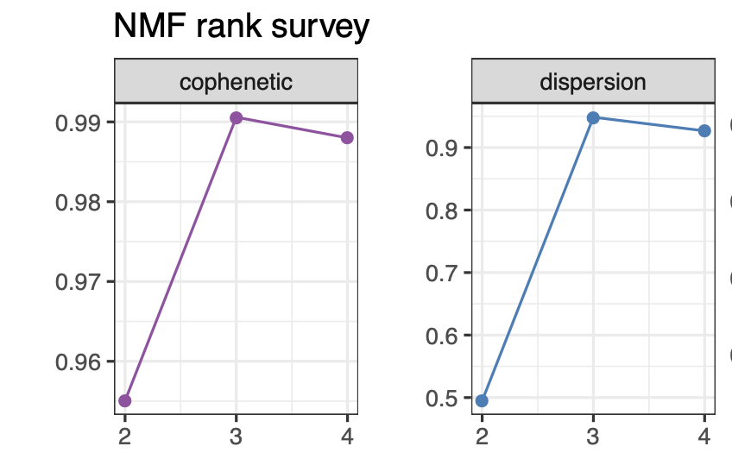
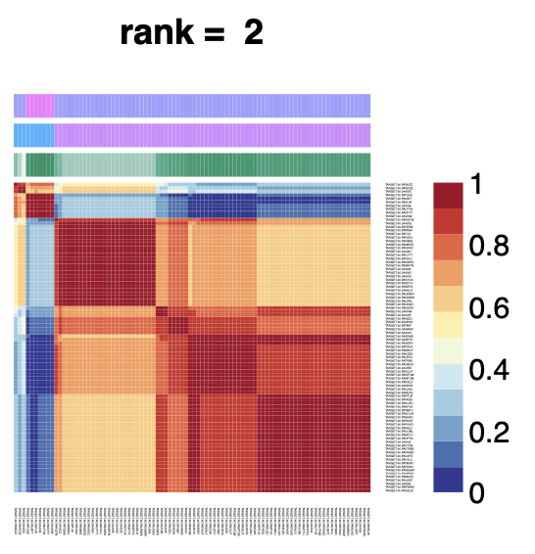
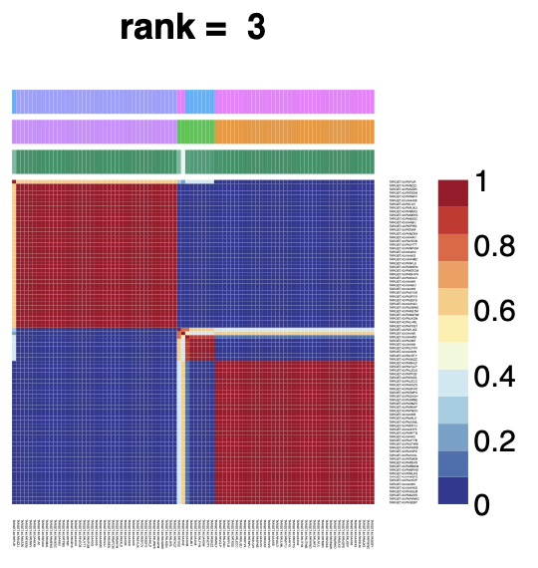
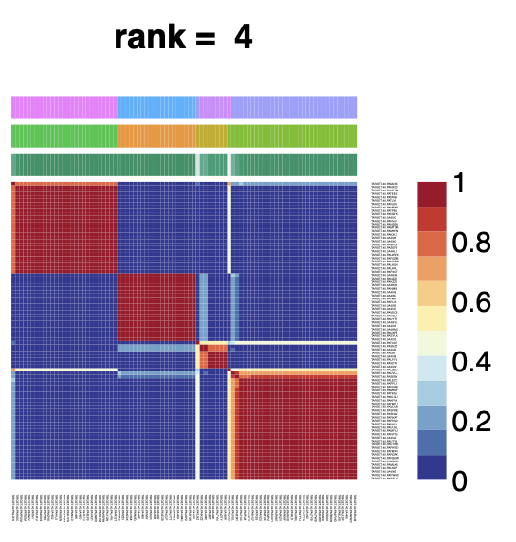
Replicating techniques from Song et. al, 2021

Slide 6
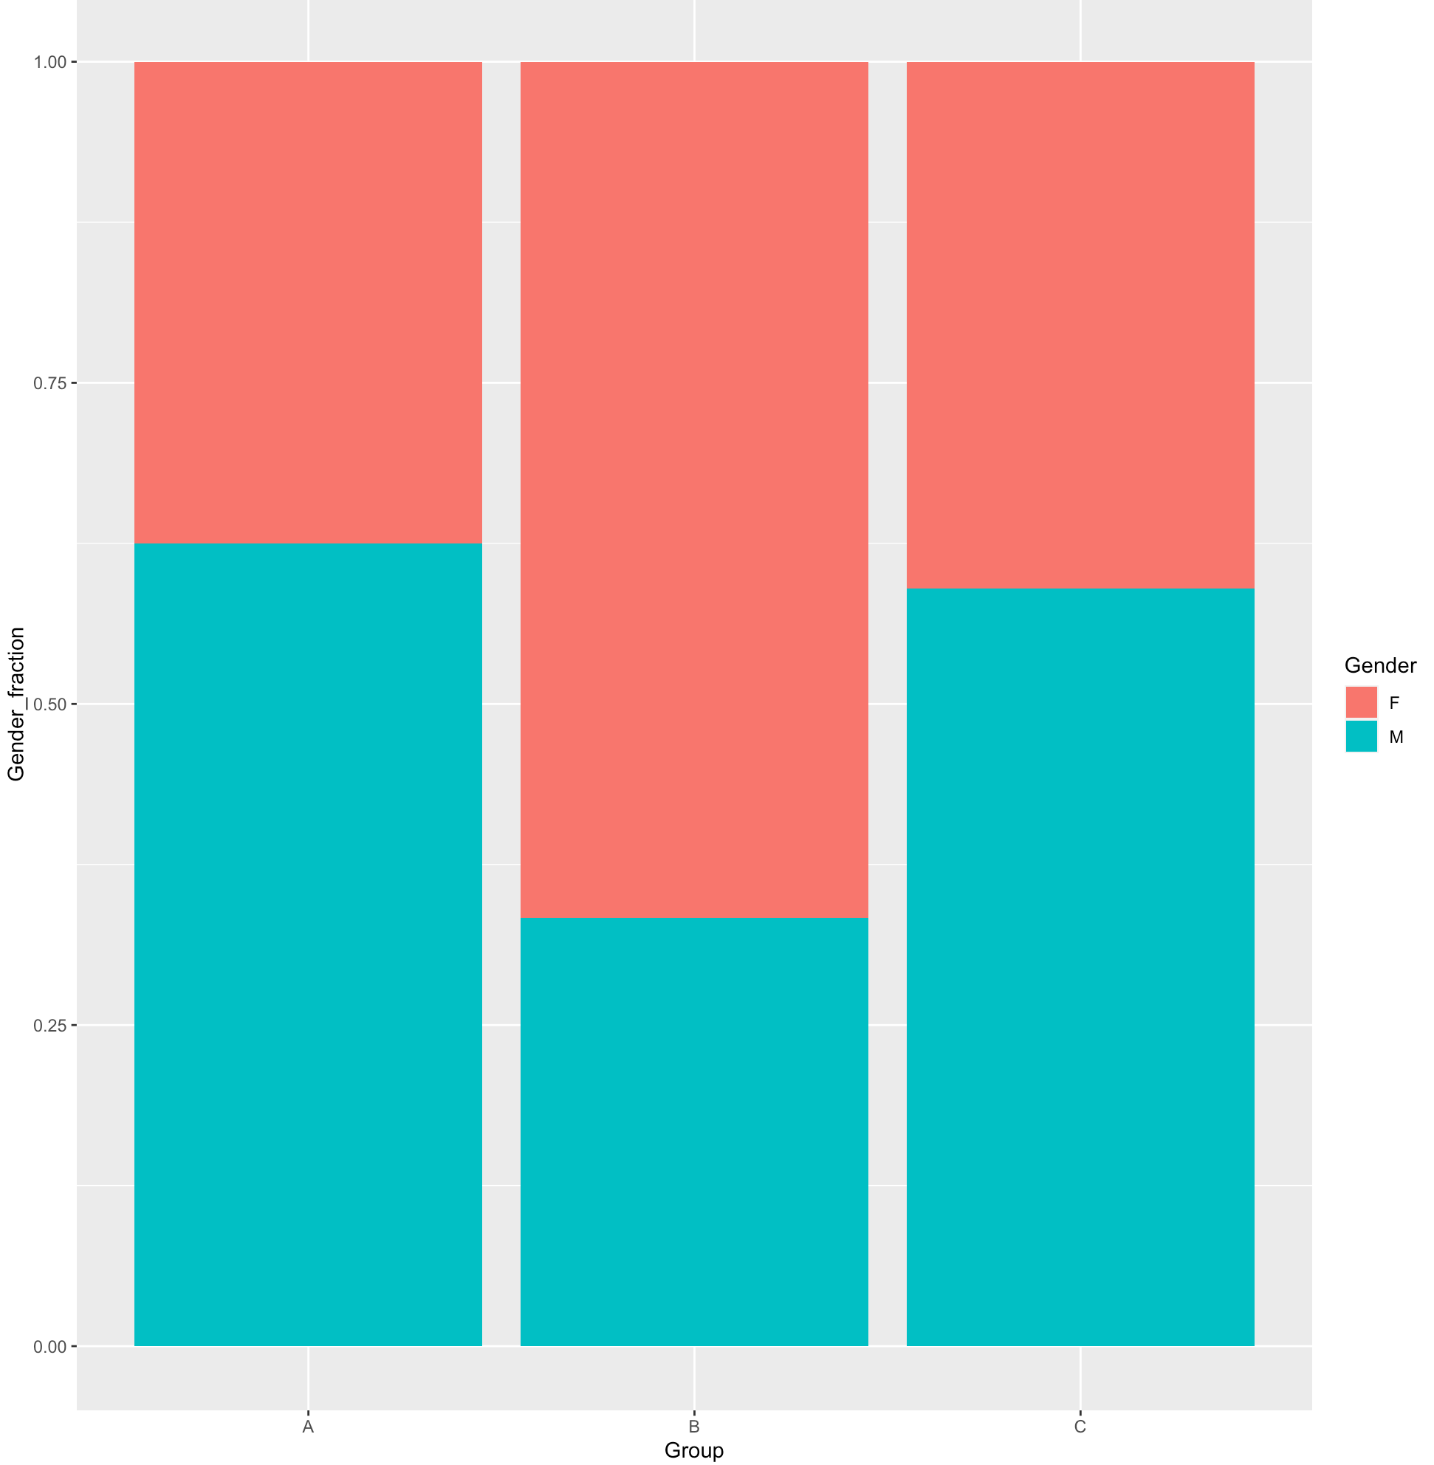
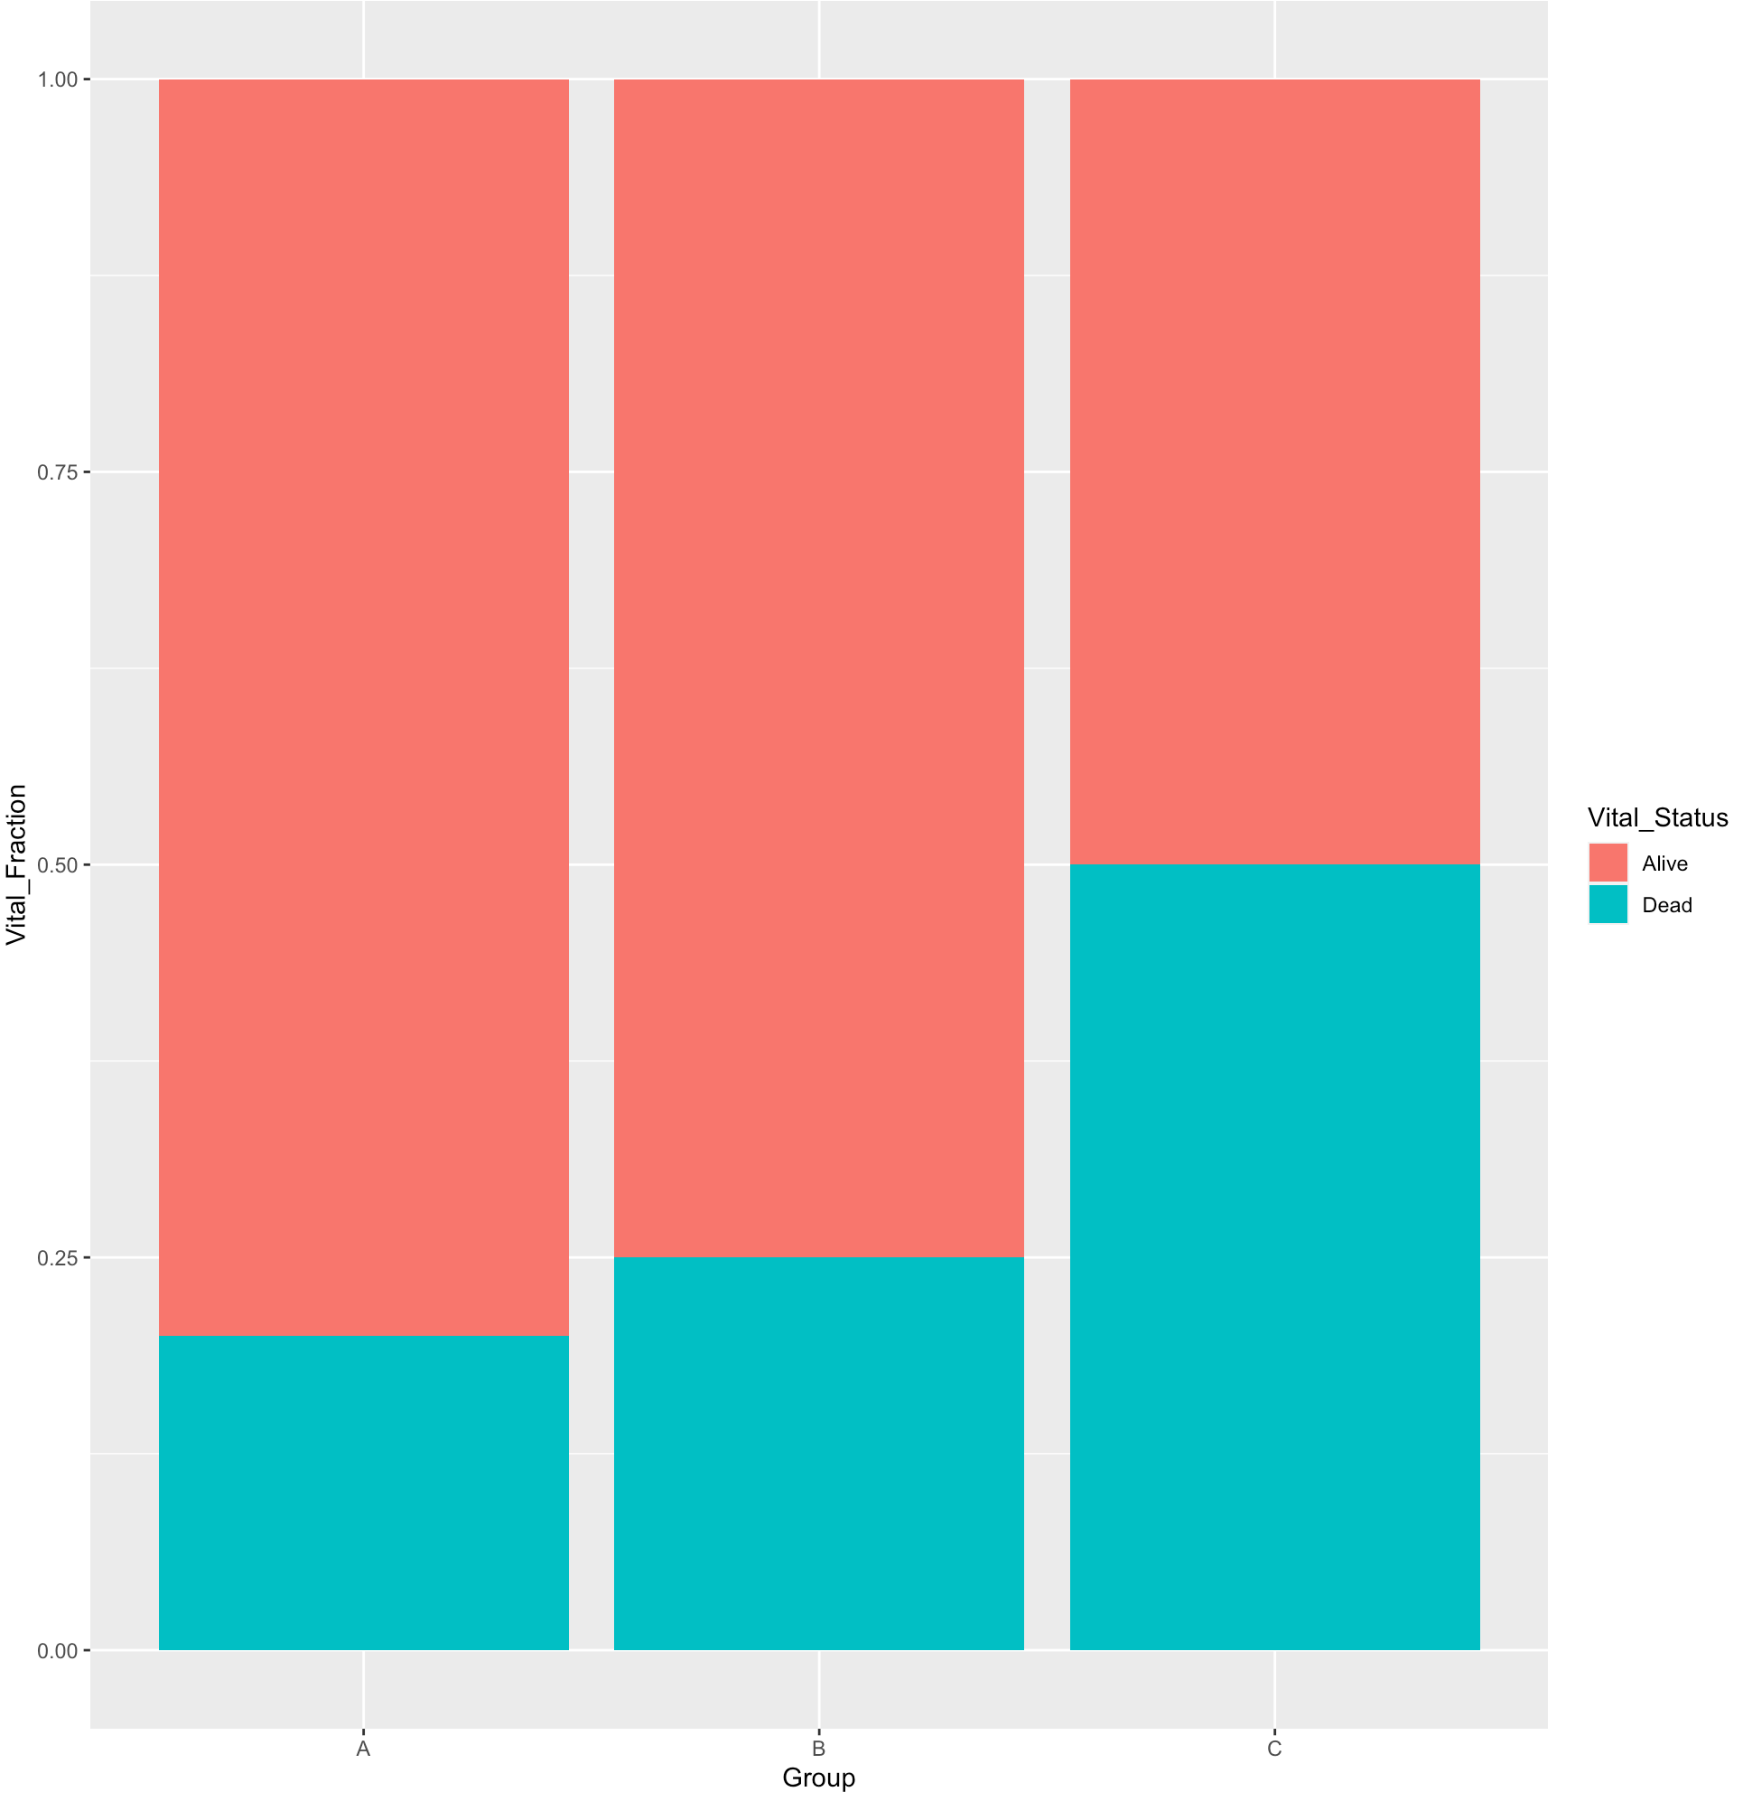
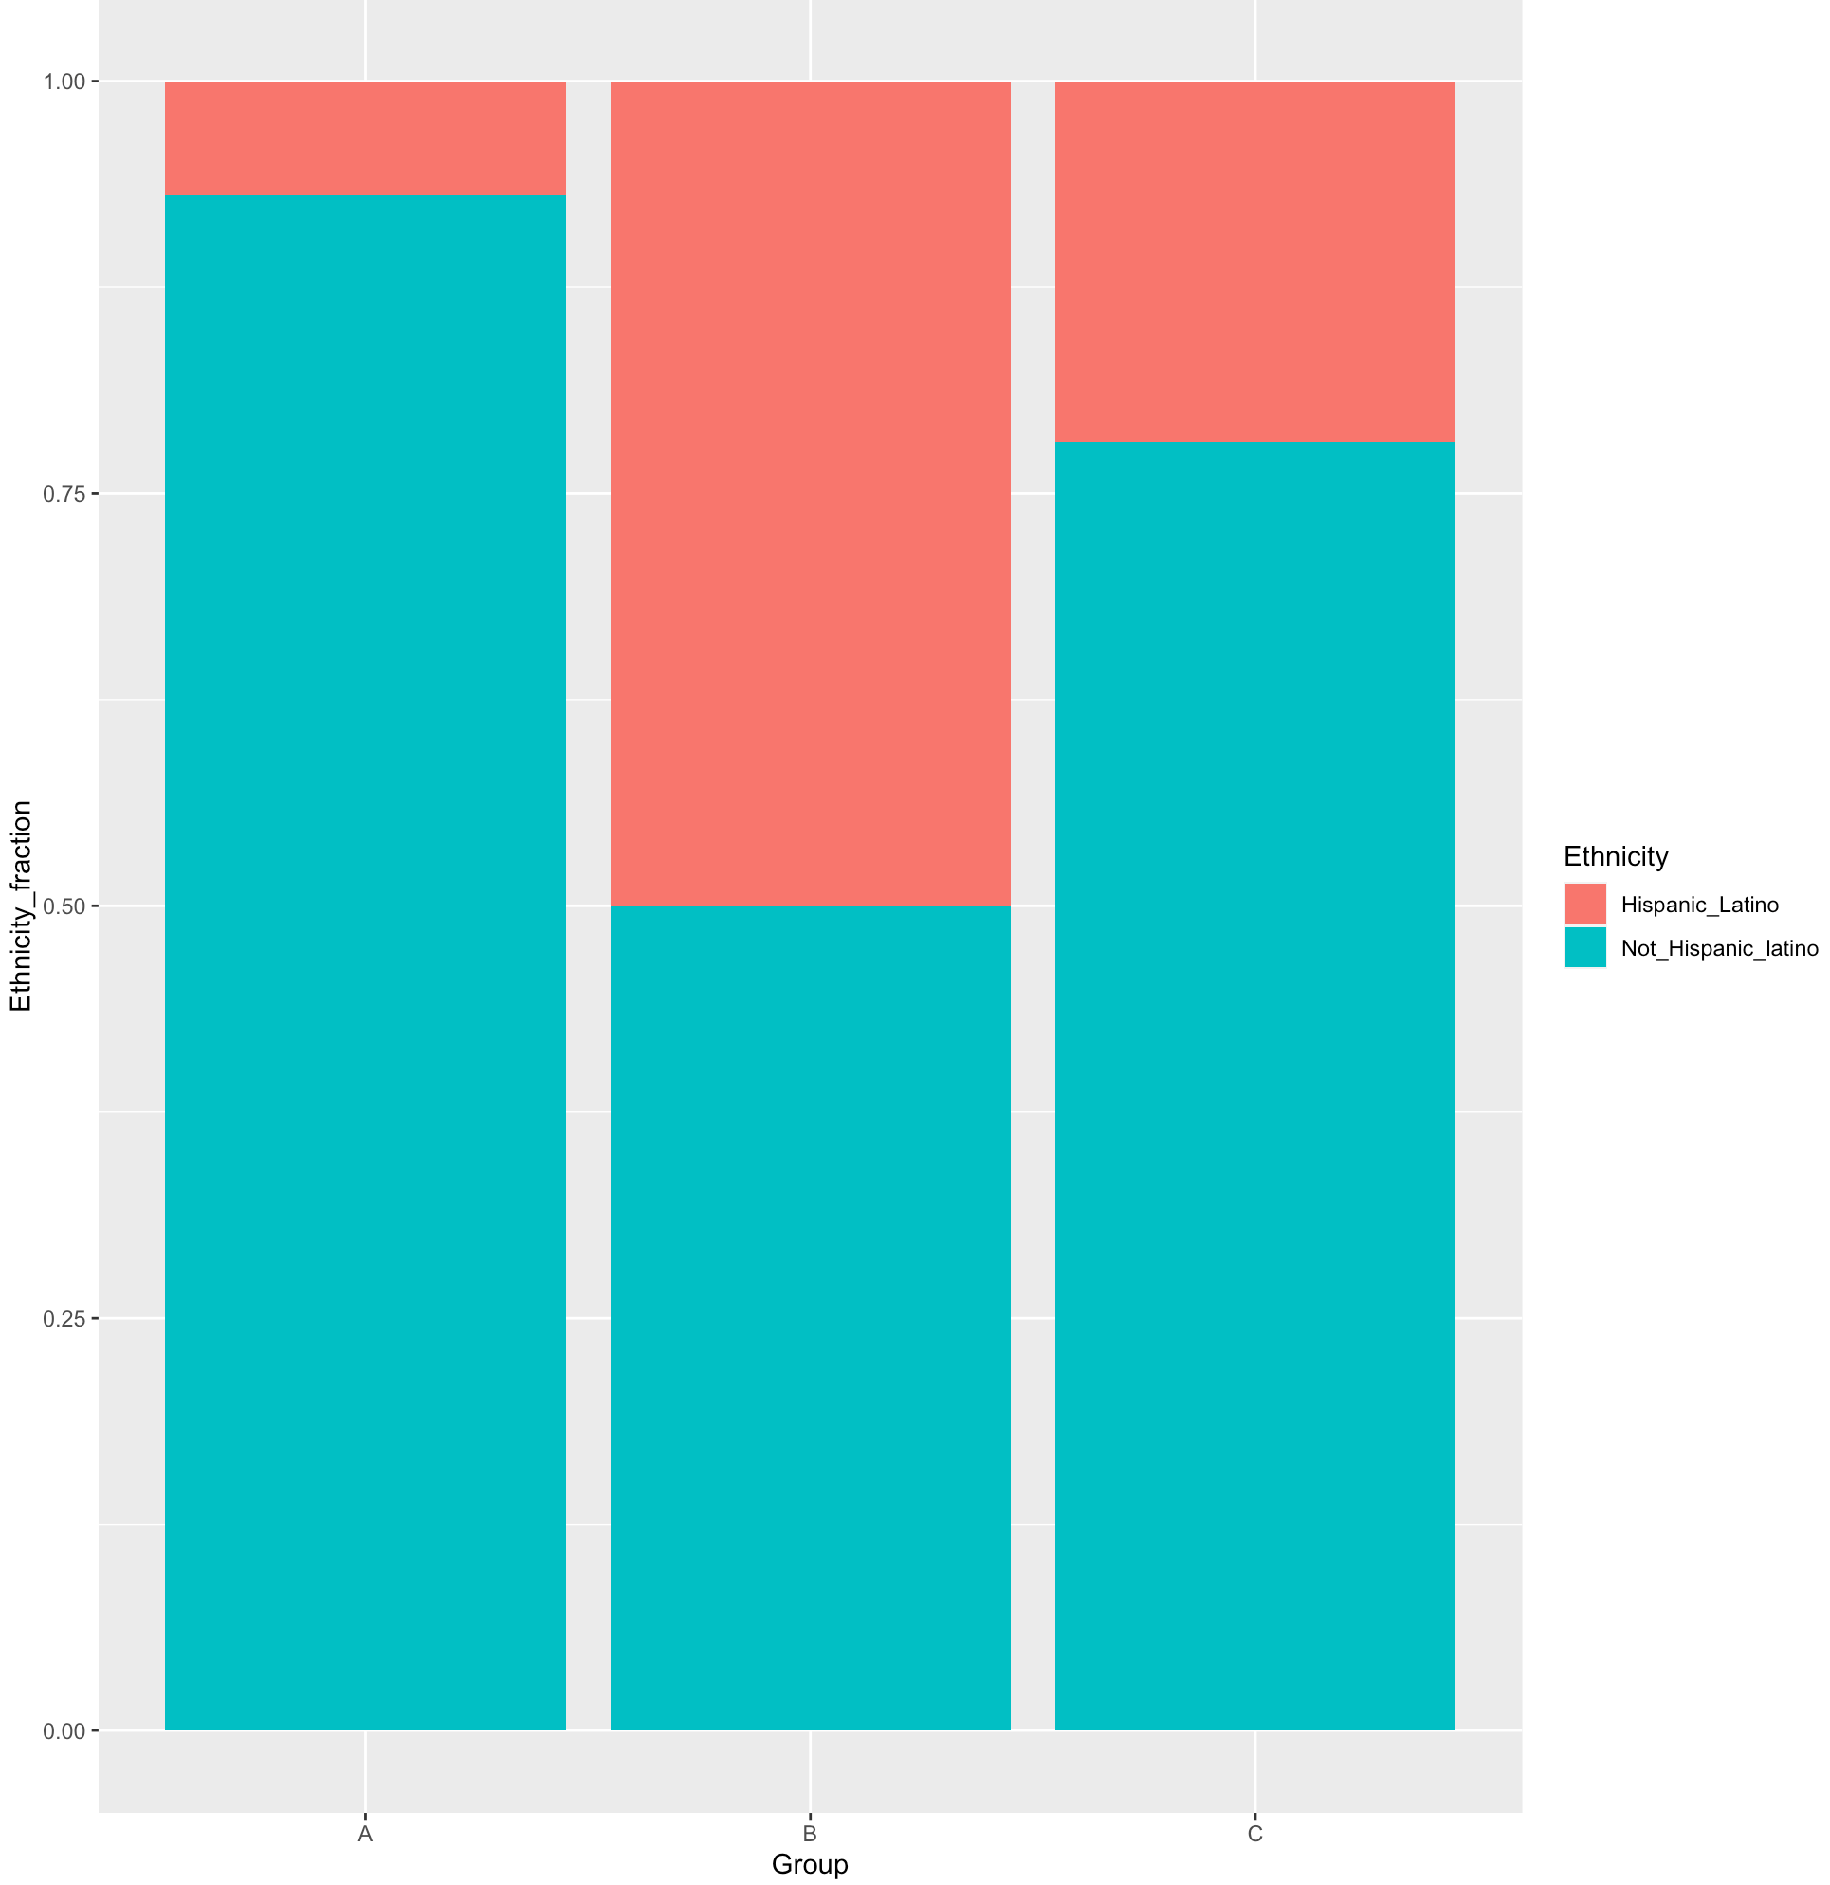
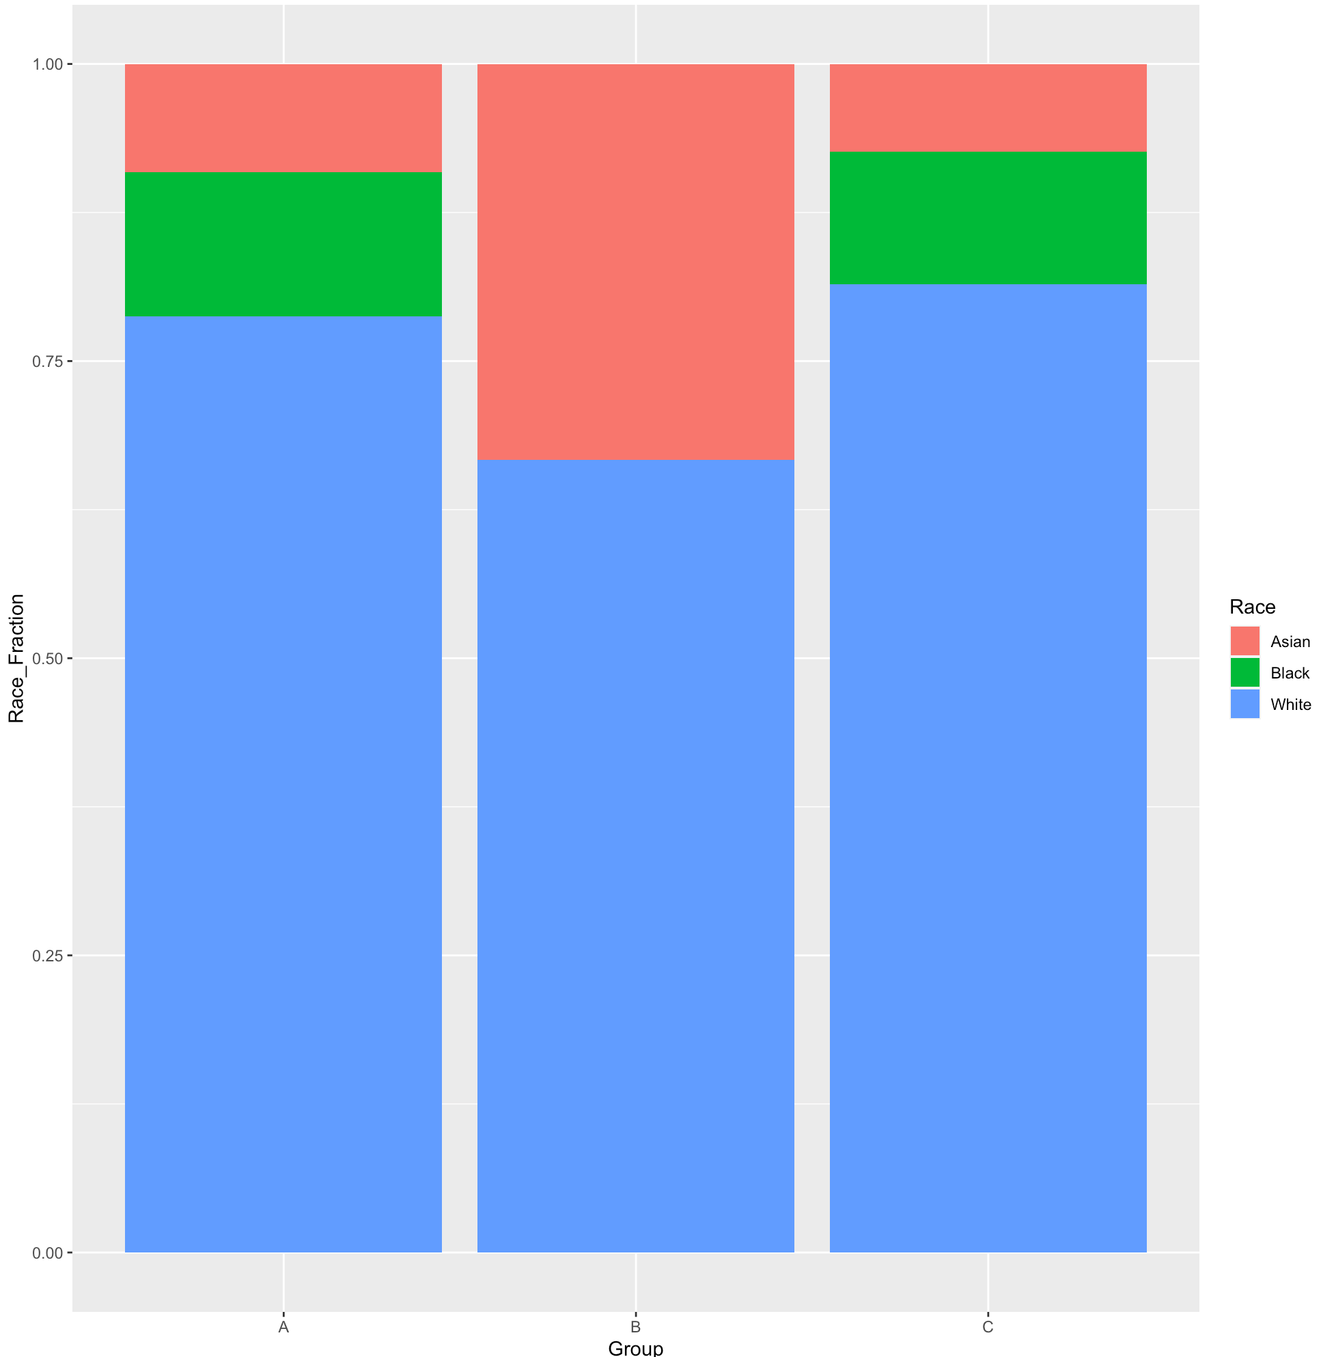
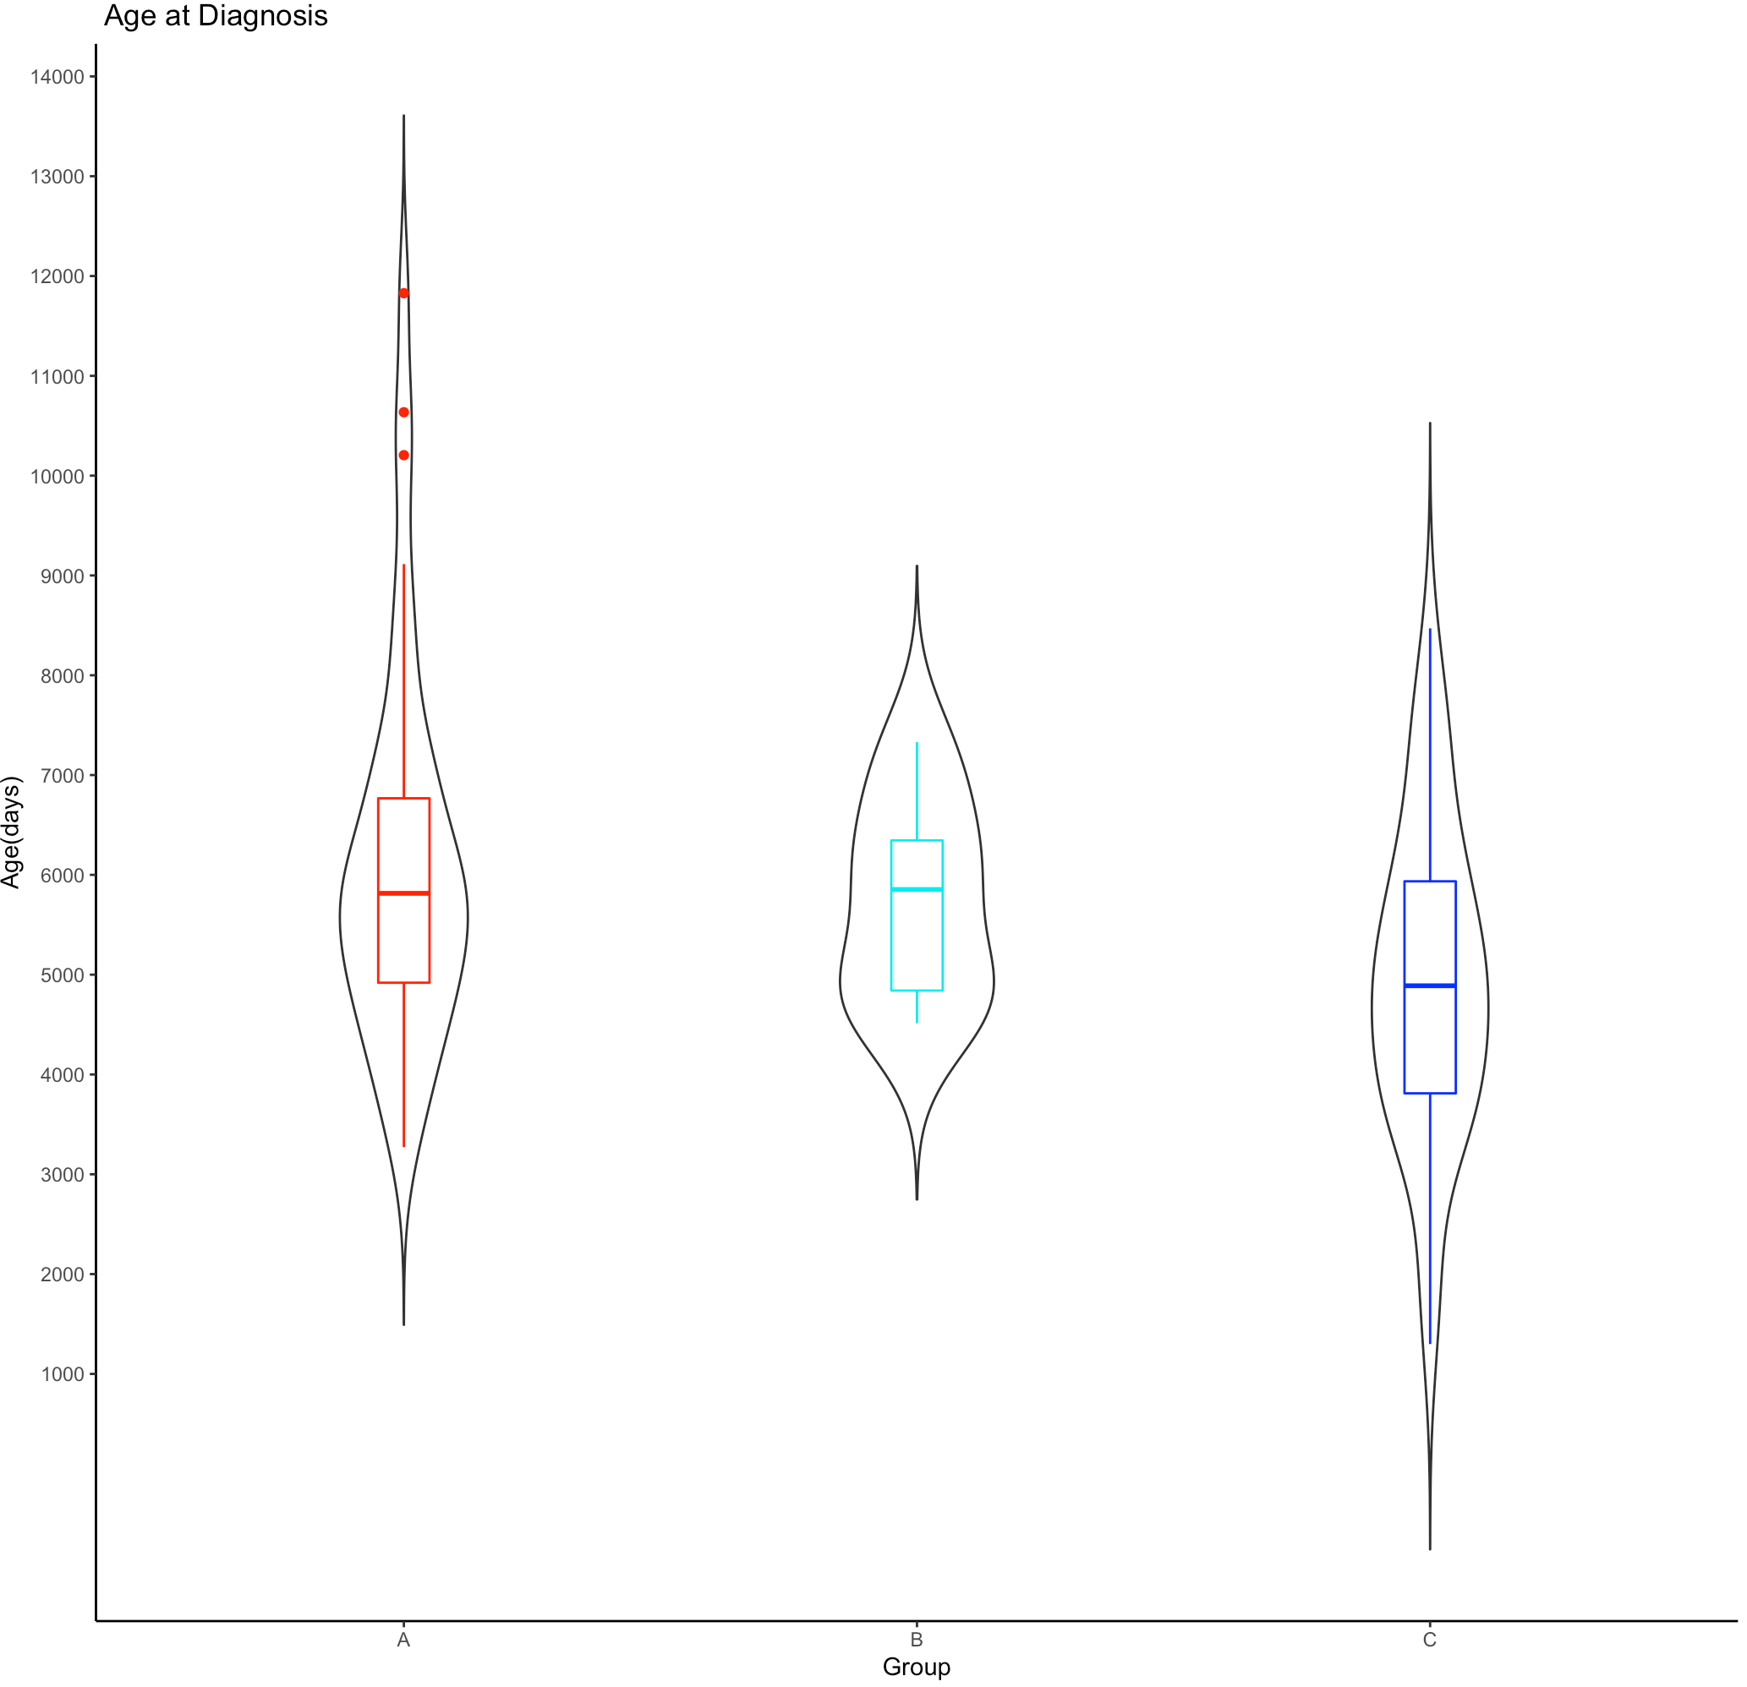
Using techniques from Song et. al, 2021
9 samples
A
B
C

Slide 7
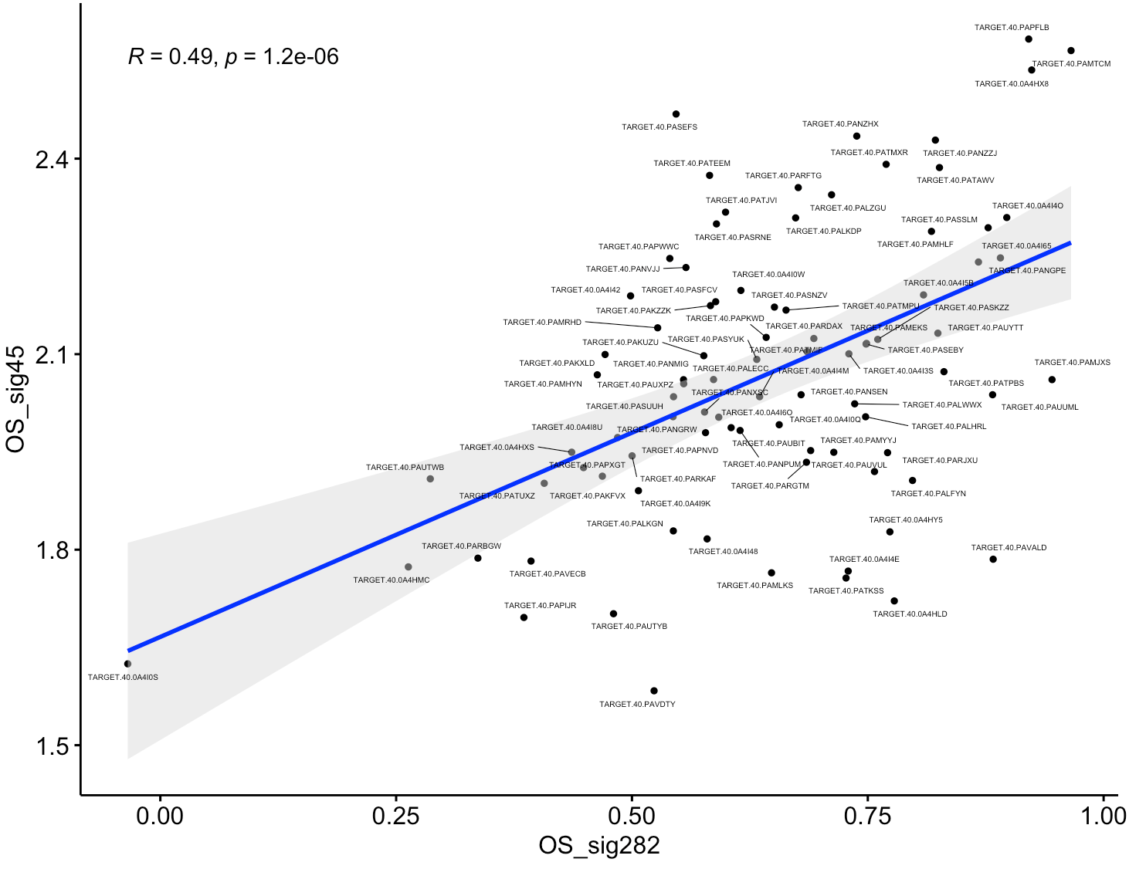

Slide 8
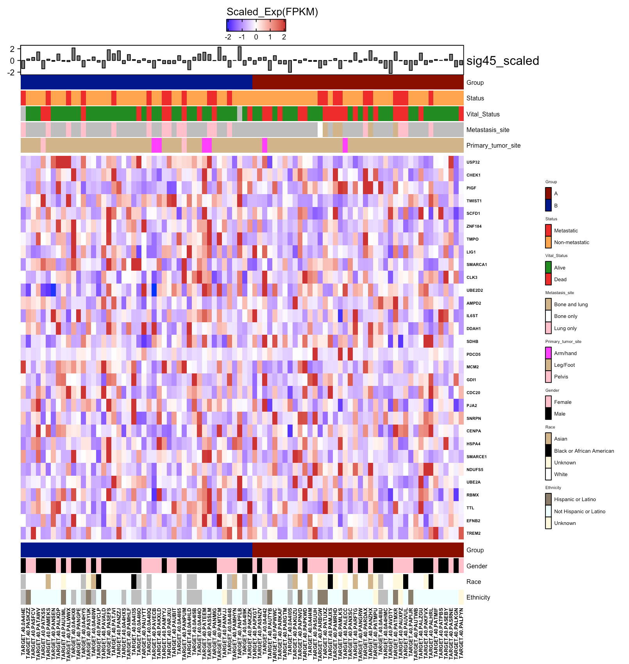
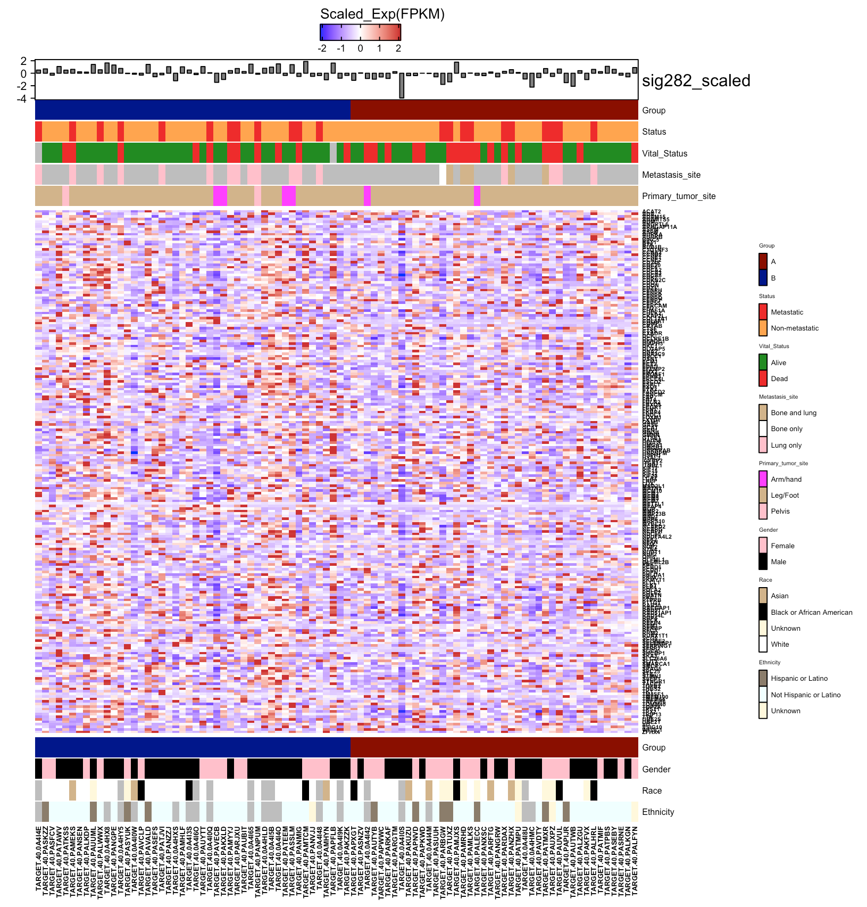
Genes from Man. et. al
Genes from Scott. et. al

Slide 9
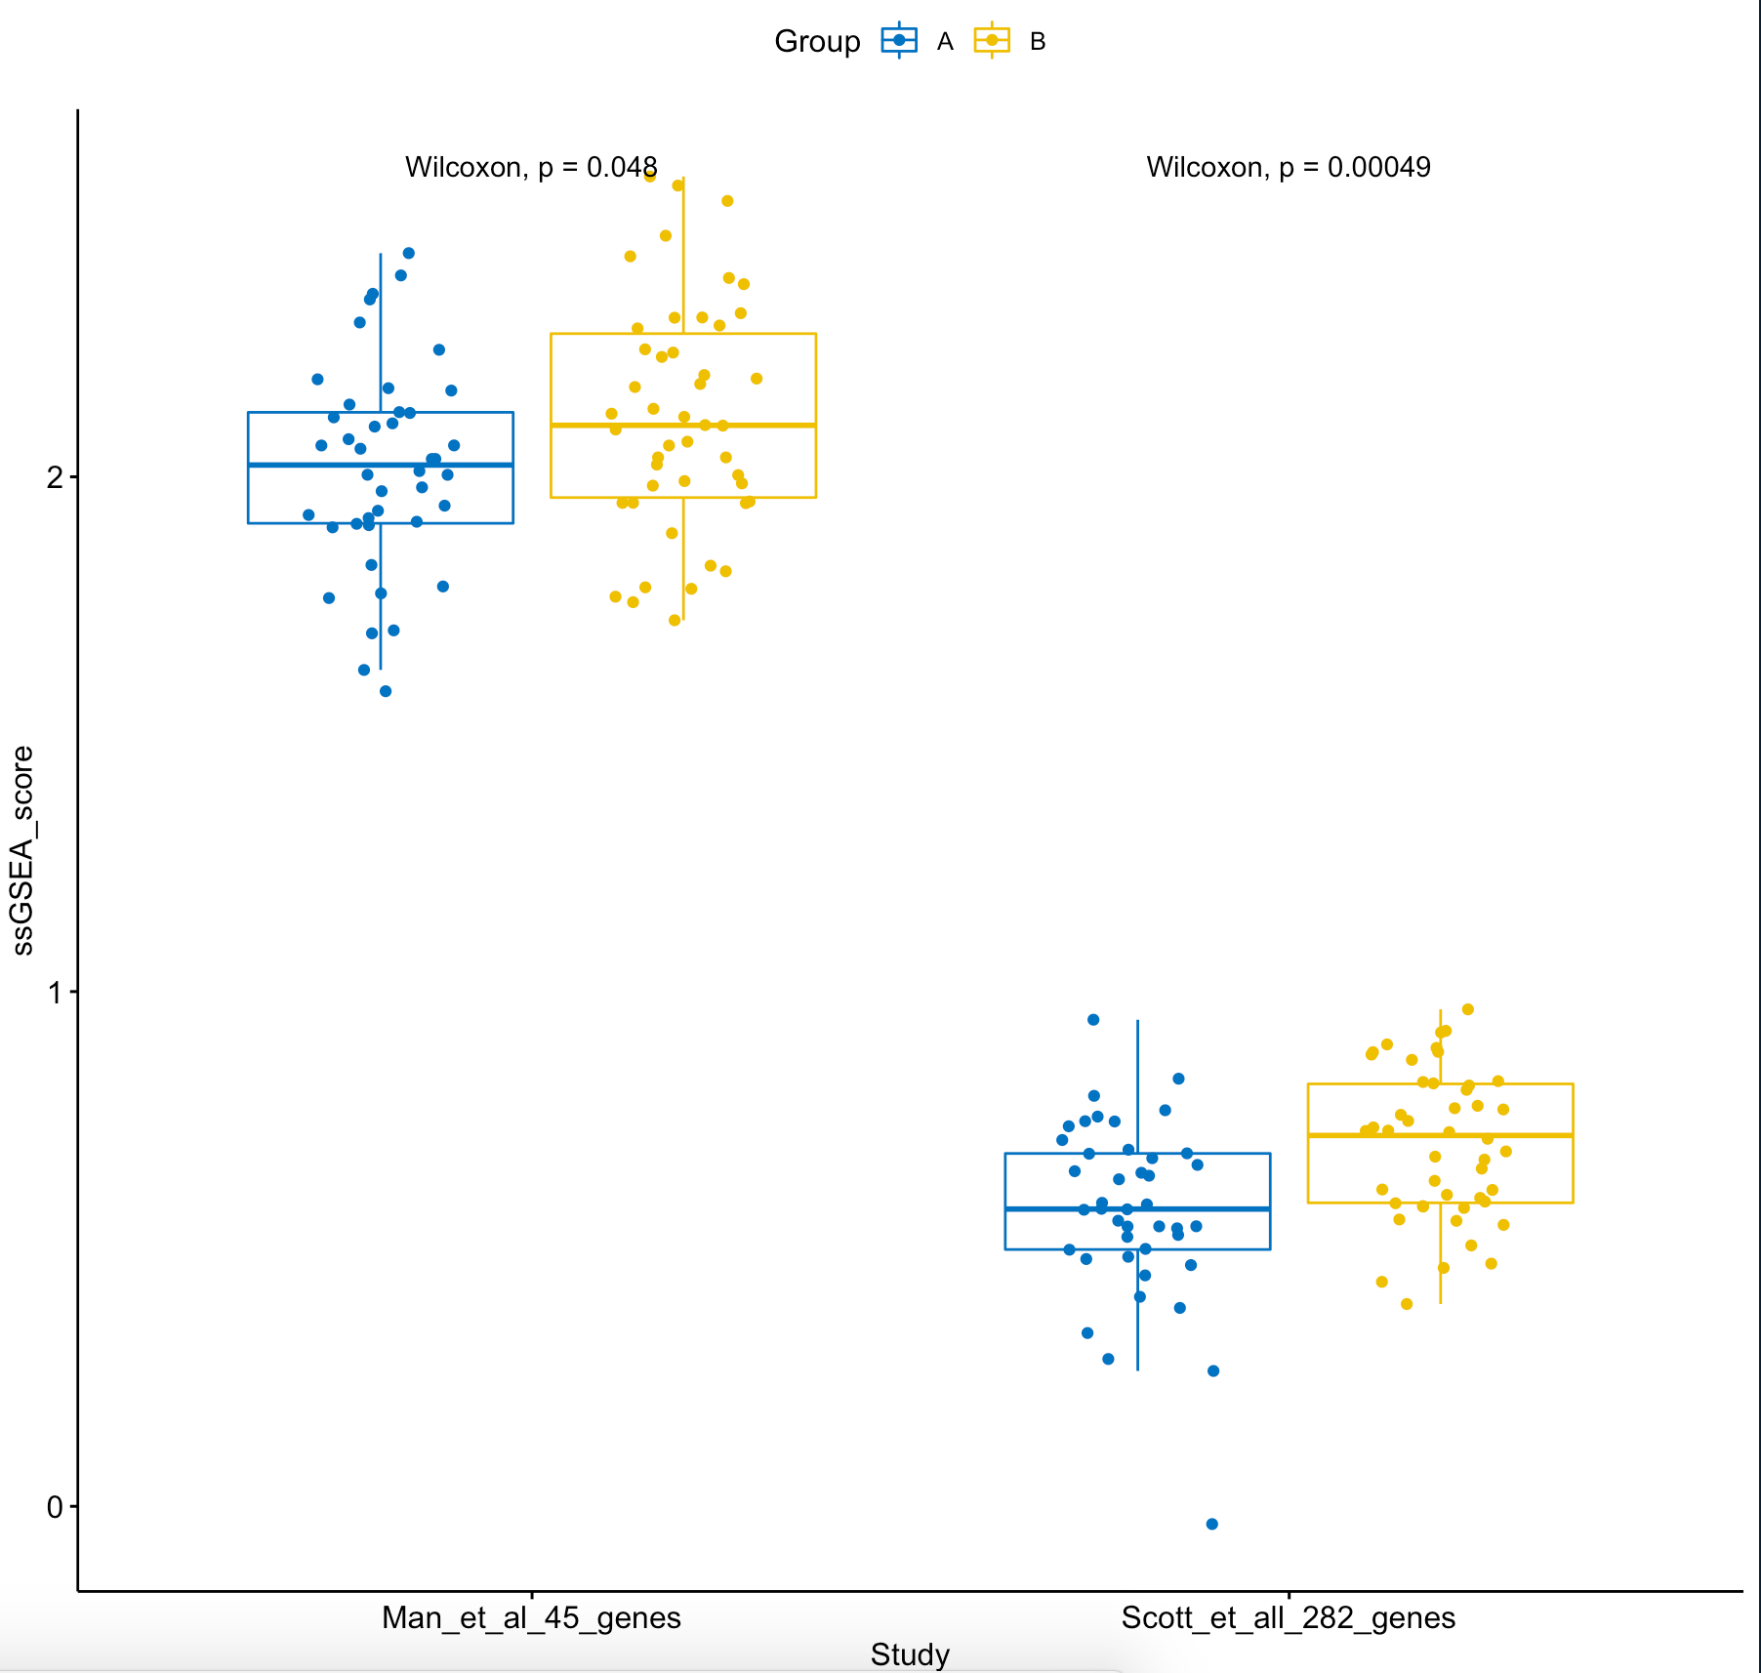
Comparing 2 groups using ssGSEA scores

Slide 10
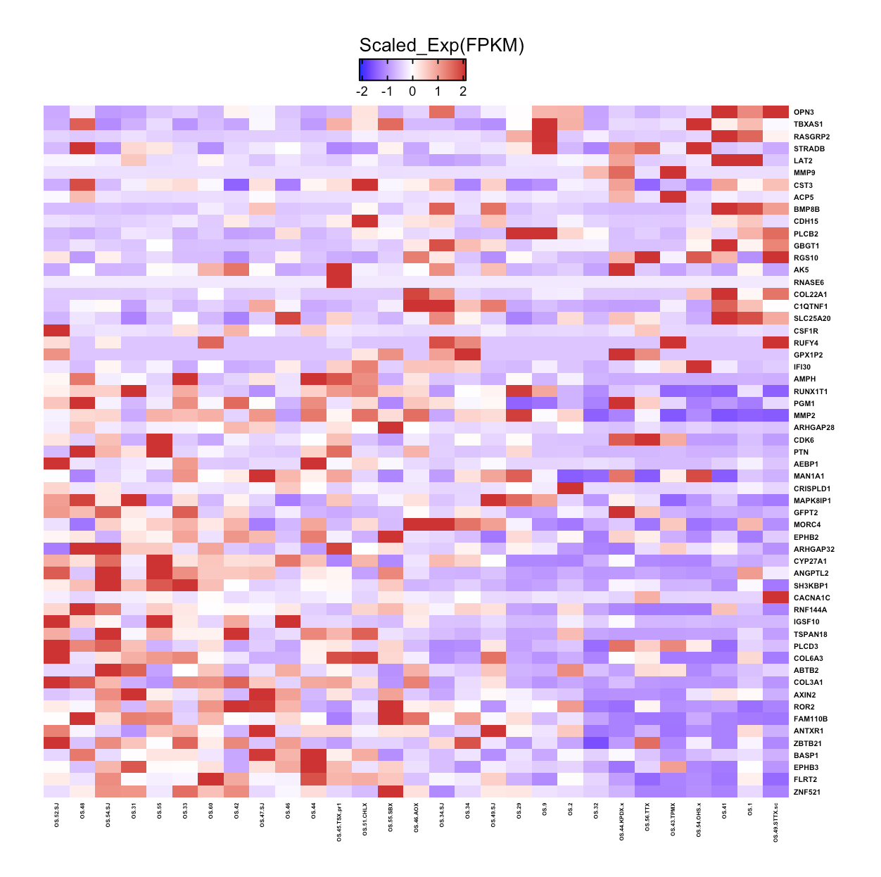
TARGET-OS Samples
PDX-OS Samples
29 samples
Run ssGSEA to assign grouping

Slide 11
Overall Survival Plot
Update on : Aug 26
Event-Free Survival Plot
Assumption: Event = Death = 1/TRUE,
Alive = 0
Assumption: Event = Relapse or Death = 1/TRUE,
all other = 0
R package: Survival and survminer

Slide 12
